Slide 1
Aktorik und Sensorik mit intelligenten Materialsystemen 2
Mid-Term Exam B:
Modeling and Simulaton of a Bundle of SMA Wires Driving an Hydraulic Valve
Stefan Seelecke
Gianluca Rizzello
stefan.seelecke@imsl.uni-saarland.de
gianluca.rizzello@imsl.uni-saarland.de Saarland University

Slide 2
ASIM 2 Mid-Term Exam
We consider a bundle of N wires connected in parallel
All wires have same length y
Total force F_{TOT} equals sum of forces
Total power J_{TOT} is divided in N equal parts, and shared among wires
Total resistance R_{TOT} is given by parallel of N resistances
NOTE: you can activate/deactivate SMA internal loops by setting params_PC2.internal_loops_flag = 1 or 0, respectively. Try to solve as much problems as possible with internal loops activated, and set the flag to 0 inly in case severe numerical problems occur
y
F
F_{TOT}
SMA Actuator
N
J_{TOT}
J
R
R_{TOT}
1/N
1/N
SMA Bundle

Slide 3
ASIM 2 Mid-Term Exam
The bunle of SMA wires is working against a mass-spring-damper load
Dynamic equation
Steady-state equation (time derivatives go to zero)
y₀
y
SMA₁
b
F_{TOT}
SMA_{i}
…
m
SMA_{N}
…
k

Slide 4
ASIM 2 Mid-Term Exam
We assume that T_{E} = T₀ = 293 K, and that the wires can stand a maximum increase of ΔT = 80 K from this initial value
Given a maximum increase of temperature of ΔT = 80 K, the maximum power J_{TOT} which can be applied to the wire, denoted as J_{MAX}, can be obtaind from the thermal equation, by setting all derivative equal to zero
J_{MAX} has to be recalculated every time geometry/number of wires are modified
r₀
l₀

Slide 5
ASIM 2 Mid-Term Exam
GOAL: design and simulate a bundle SMA actuator system which drives a hydraulic valve
Implement in Simulink the model of the SMA bundle. Simulate the SMA force/displacement hystesis loop of the SMA bundle y-F_{TOT} for J_{TOT} = 0 and J_{TOT} = J_{MAX}, for different wire lenghts l₀ and number of SMA wires in the bundle N. When deforming the wire, design y in such a way the strain ε ranges from 0 to 0.048, at 0.01 Hz. Show how hysteresys changes while changing both parameters. NOTE: If J_{MAX} is chosen properly, the temperature of activated wire allways be equal 373 K (100 °C).
Assume the SMA bundle working against a linear spring with elastic constant k = 500 N/m only, at steady state. By using graphical method, design optimal values of SMA length l₀, number of wires N, and spring pre-deflection y₀ such that, when actuated with J_{MAX}, the actuator produces a displacement (i.e., difference between off and on position) of at least 0.022 m.

Slide 6
ASIM 2 Mid-Term Exam
By considering previously designed SMA and linear spring, simulate the response of a mass-spring-damper-SMA bundle actuator, described as follows Assume previously designed values for SMA length and number of wires, spring stiffness and pre-deflection, and use m = 0.3 kg, b = 10 N*s/m. Apply a square wave input joule heating from 0 to J_{MAX,} with period 10 seconds and duty cycle of 50%, and plot temperature T over time and normalized stroke s over time, where where y is the current SMA length, and y_{in} is the SMA length when the wire is not actuated (i.e., J_{TOT} = 0). Both y and y_{in} are expressed in meters. NOTE: do not forget to set reasonable initial conditions.

Slide 7
ASIM 2 Mid-Term Exam
Assume that the SMA wire is used to drive a proportional hydraulic valve, whose flow rate q (unit: m³/s) is given as follows where ρ = 865 kg/m³ is the fluid density (oil), ΔP = 400000 Pa is the pressure difference of the valve, A = 0.0005 m² is the cross-sectional area of the fully open valve,η = 0.9 is a loss factor, and

Slide 8
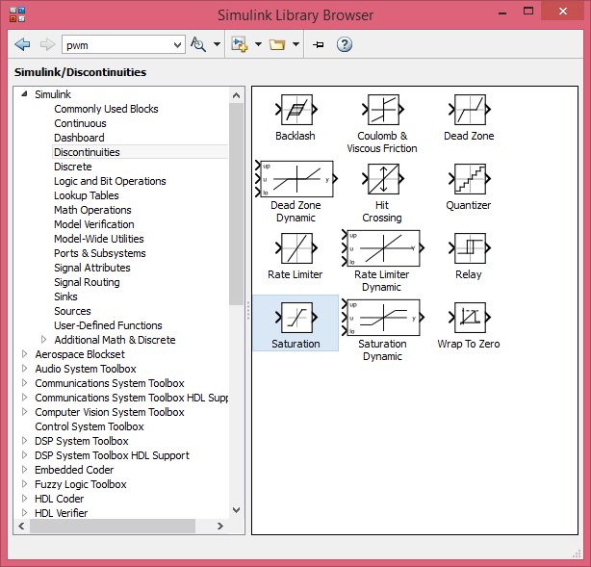
ASIM 2 Mid-Term Exam
HINT: to implement sat(s), you can use saturation block in Simulink

Slide 9
ASIM 2 Mid-Term Exam
Construct a block diagram for the overall SMA driven valve
By applying the square wave joule heating input from 0 to J_{MAX} , period of 10 s, plot the resulting flow rate-resistance (q - R_{TOT}) curve. Find the best line which approximates such a relationship in terms of coefficients a₁ and a₀, in the following form
s
q
LOAD
y
F_{TOT}
SMA Bundle
J_{TOT}
R_{TOT}

Slide 10
ASIM 2 Mid-Term Exam
Use previous relationship to reconstruct flow rate from resistance R_{TOT}. Define as the flow rate estimated from resistance. Then, based on estimated flow rate , implement a sensorless PI flow rate control loop. Design the PI gains (e.g., via hand-tuning) in such a way the closed loop system is able to track constant step references sufficiently fast and without large overshoot/oscillations.
s
q
LOAD
y
F_{TOT}
SMA Bundle
J_{TOT}
R_{TOT}

Slide 11
ASIM 2 Mid-Term Exam
For the flow rate set-point q*, use Simulink to generate a uniform random number ranging from minimum to maximum attainable flow rate (corresponding to s = 0 and s = 1, respectively), with a period of 2 s.
Plot the resulting real flow rate, estimated flow rate, together with set point, and other relevant quantities (e.g., Joule heating).
s
q
LOAD
y
F_{TOT}
SMA Bundle
q*
e
J_{TOT}
R_{TOT}
+
PI
-

Slide 12
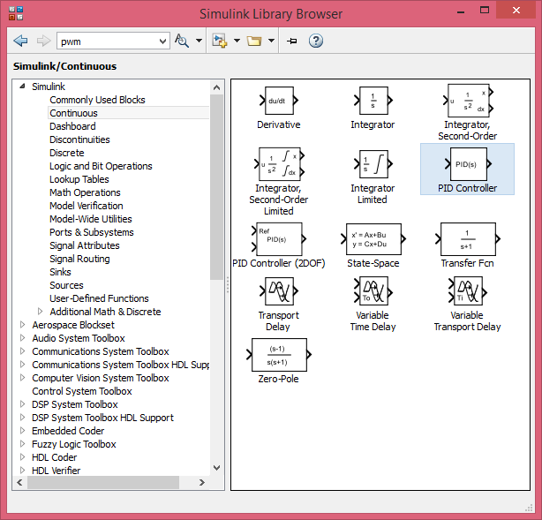
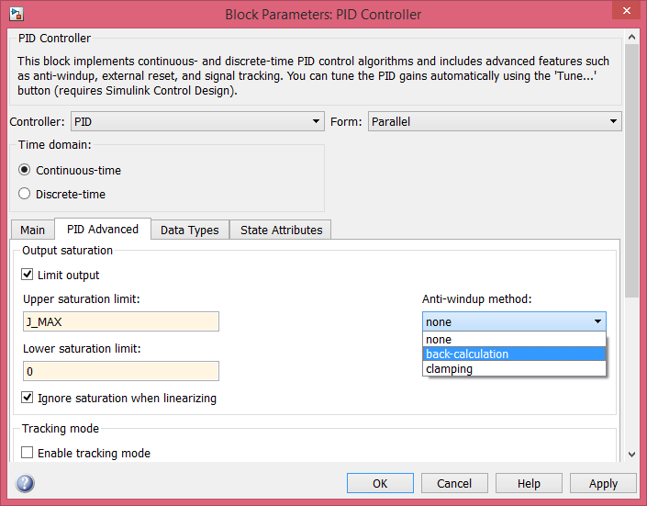
ASIM 2 Mid-Term Exam
In control loop, control input of SMA, i.e., J_{TOT}, has to be limited between its physical limits 0 and J_{MAX} with a saturation block.
In order to work properly with satuation, PI control has to be implemented in an anti-windup configuration. To do so, it is possible to use built-in blocks in Simulink.

Slide 13
ASIM 2 Mid-Term Exam
Results must be presented with a presentation done in PowerPoint (or any similar software), in either german or english, which includes plot of the most significant quantities and comments on the results.
Results an be presented by groups of 3 people (or 2, if needed).
For each group, 10 minutes presentation + 5 minutes for questions.
MID-TERM EXAM B DATE: 15/06/2018, at 13:00

